Slide 1
Creatieve makers
What?
An initiative from KULeuven and LUCA | School of Arts
Inter-disciplinary curriculum for engineers, architects and artists.
How?
Elective/summerschool, workshops, makerspace, VR/AR/XR lab

Slide 2
Summerschool: Sense adapt create
September 5th-15th
Castle “Ter Beken” Mariakerke

Slide 3
Sense
Geometric data capture (pointclouds, lidar, photogrammetry)
Capturing the invisible layer (wifi, bluetooth, etc)
Building sensors

Slide 4
Adapt
Data processing /reconstruction (drawing, programming, modeling, rendering, simulating, 3dprinting, visualising)

Slide 5
Create
- Building a conceptual framework
Iterative and Non-lineair process
- Representational methods (AR/VR, XR, game, video, installation, etc..)
Notes:
µ

Slide 6
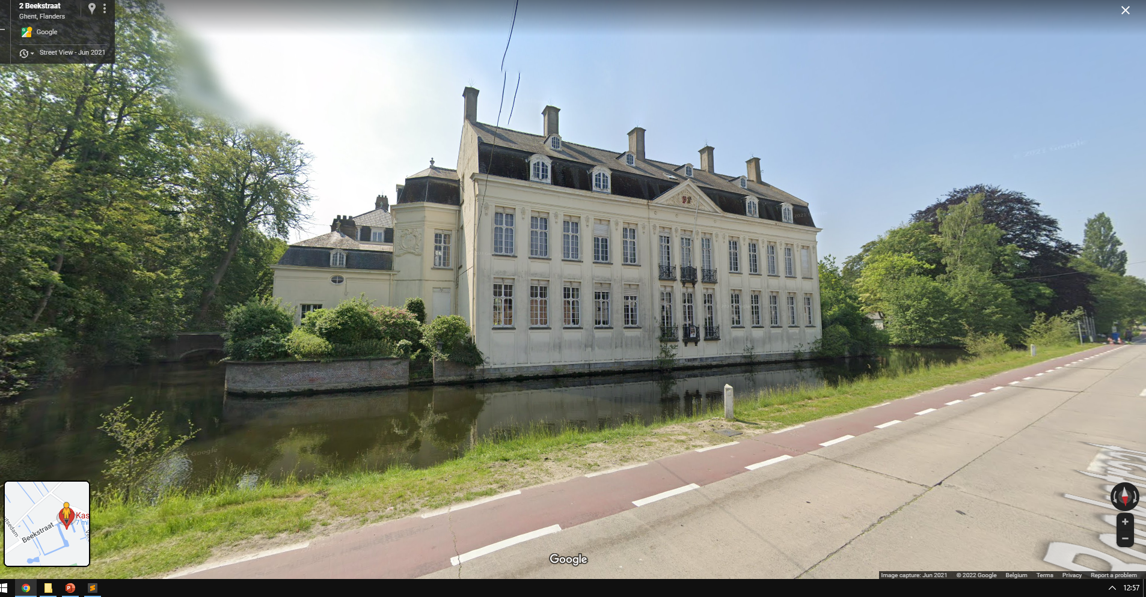
Team
dr. Gilles Callebaut , dr. Corneel Cannaerts, drs. Weronika Gajda, dr. Liselotte Vroman , Joris Putteneers, Kasper Jordaens
When?
September 5th-15th
Where?
Kasteel “Ter Beken”, Mariakerke;
Campus Sint-Lucas and Ghent Technology Campus. Accomodation for participants is provided during the period of the Summer School.

Slide 7
who?
3th Bachelors or Master students in the fields of Architecture, Urban Design, Arts and Engineering, as well as young reseachers and recent graduates coming from the aforementioned fields.
6 study points ( 3 summerschool & 3 in the 1st sem)
Deadline for application:
June 6th 2022
Interested candidates should send their CV, a motivation letter (maximum 300 words in English), including a link to a portfolio (if relevant) to: summerschool@creativemakers.xyz
Confirmation of acceptance: June 27th 2022

